Slide 2
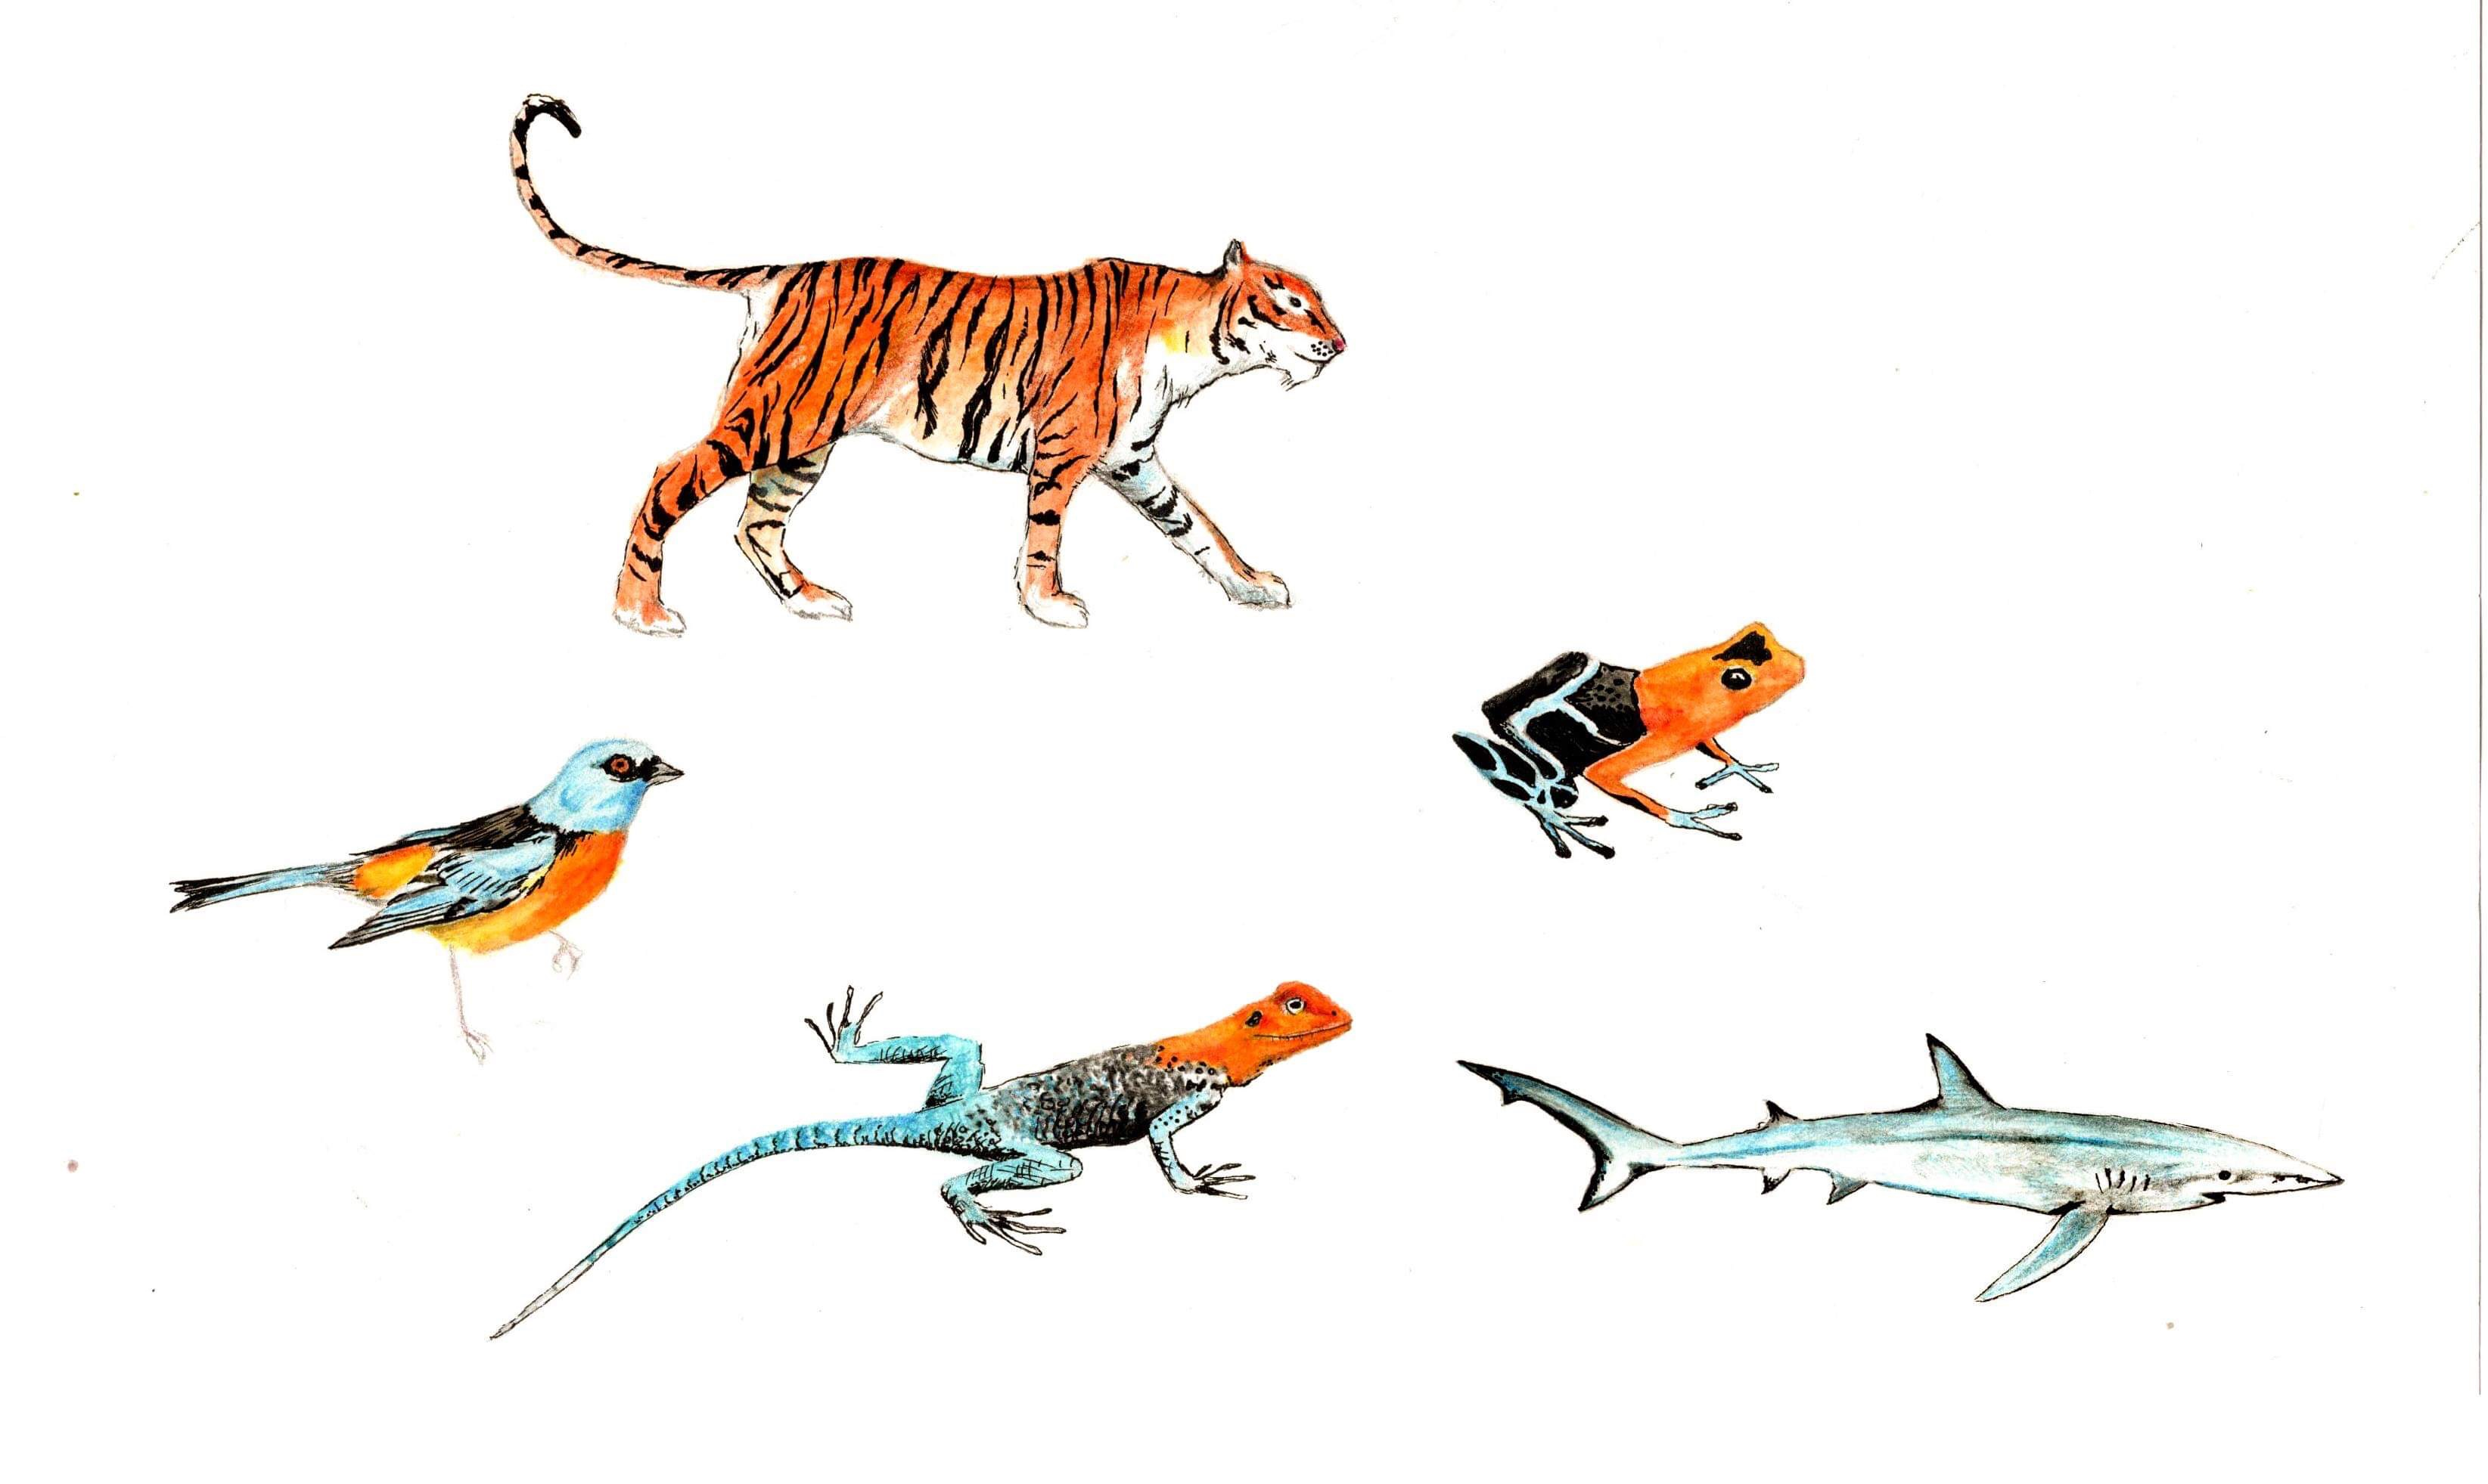
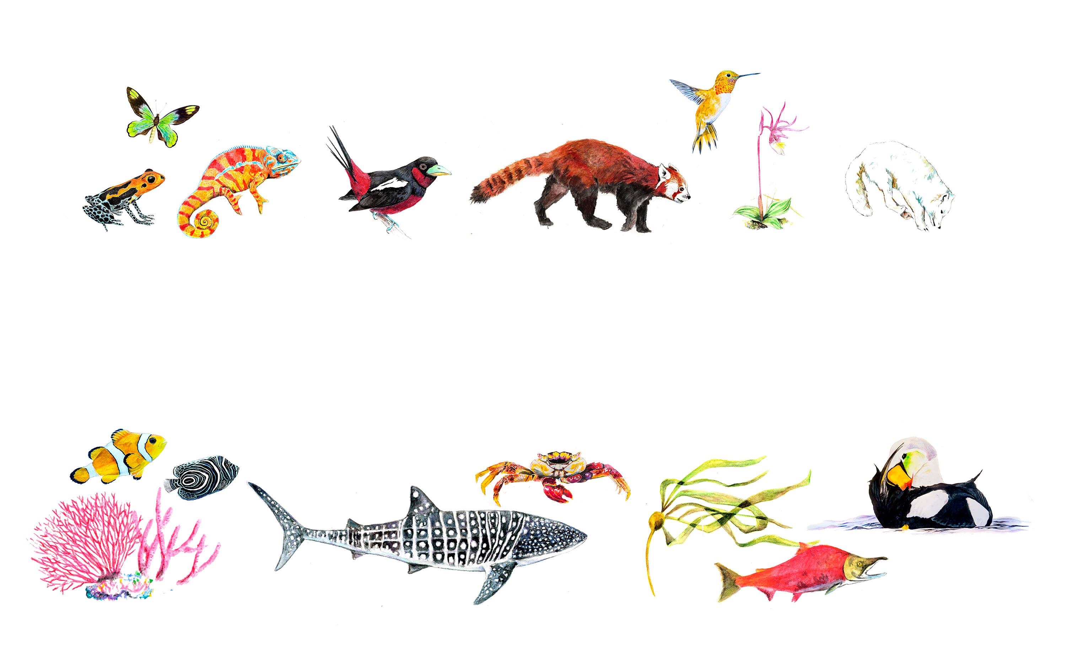

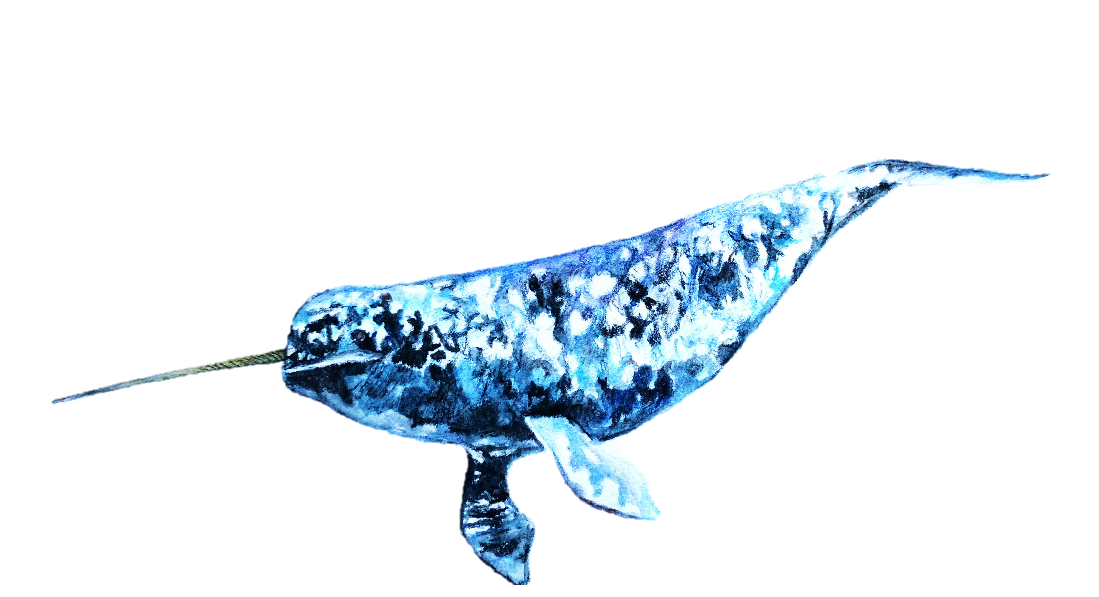
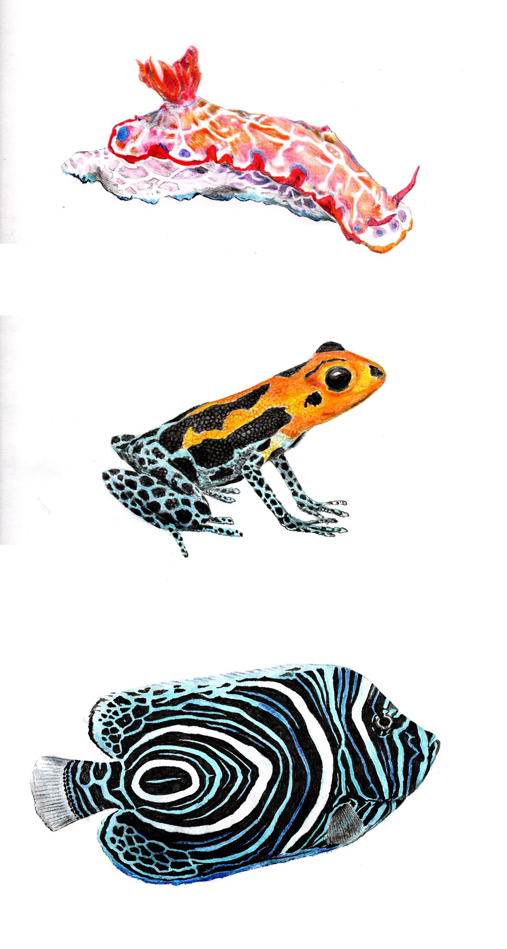

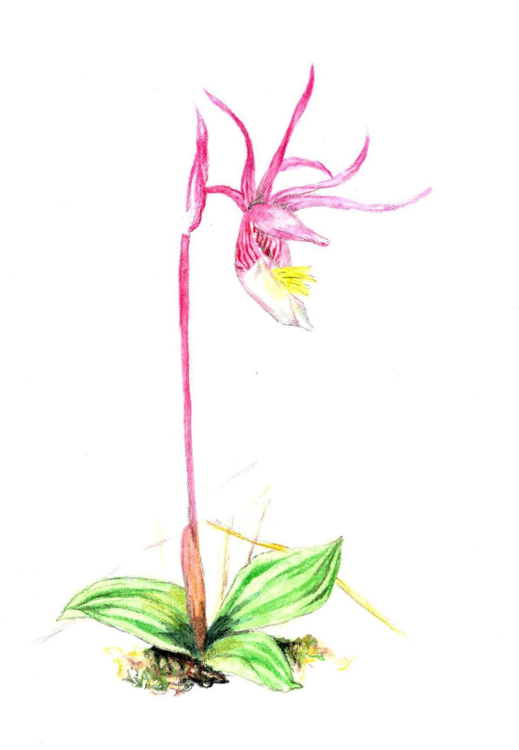
LPD BioTIME PREDICTS
In database / Known
Birds
968 / 10,356
2263 / 10,356
3199 / 10,356
Bony fish
1%
544 / 32,513
6140 / 32,513
0 / 32,513
Mammals
306 / 5,852
285 / 5,852
577 / 5,852
Amphibians
1%
78 / 6,439
114 / 6,439
397 / 6,439
Sharks
62 / 1,226
0 / 1,226
0 / 1,226
Reptiles
110 / 10,233
47 / 10,233
352 / 10,233
Terrestrial plants
0 / 348,000
5965 / 348,000
7655 / 348,000
Arthropods
0 / 1,257,040
3699 / 1,257,040
8767 / 1,257,040
0%
10%
20%
30%
100%
Percentage of known species represented in databases

Slide 3
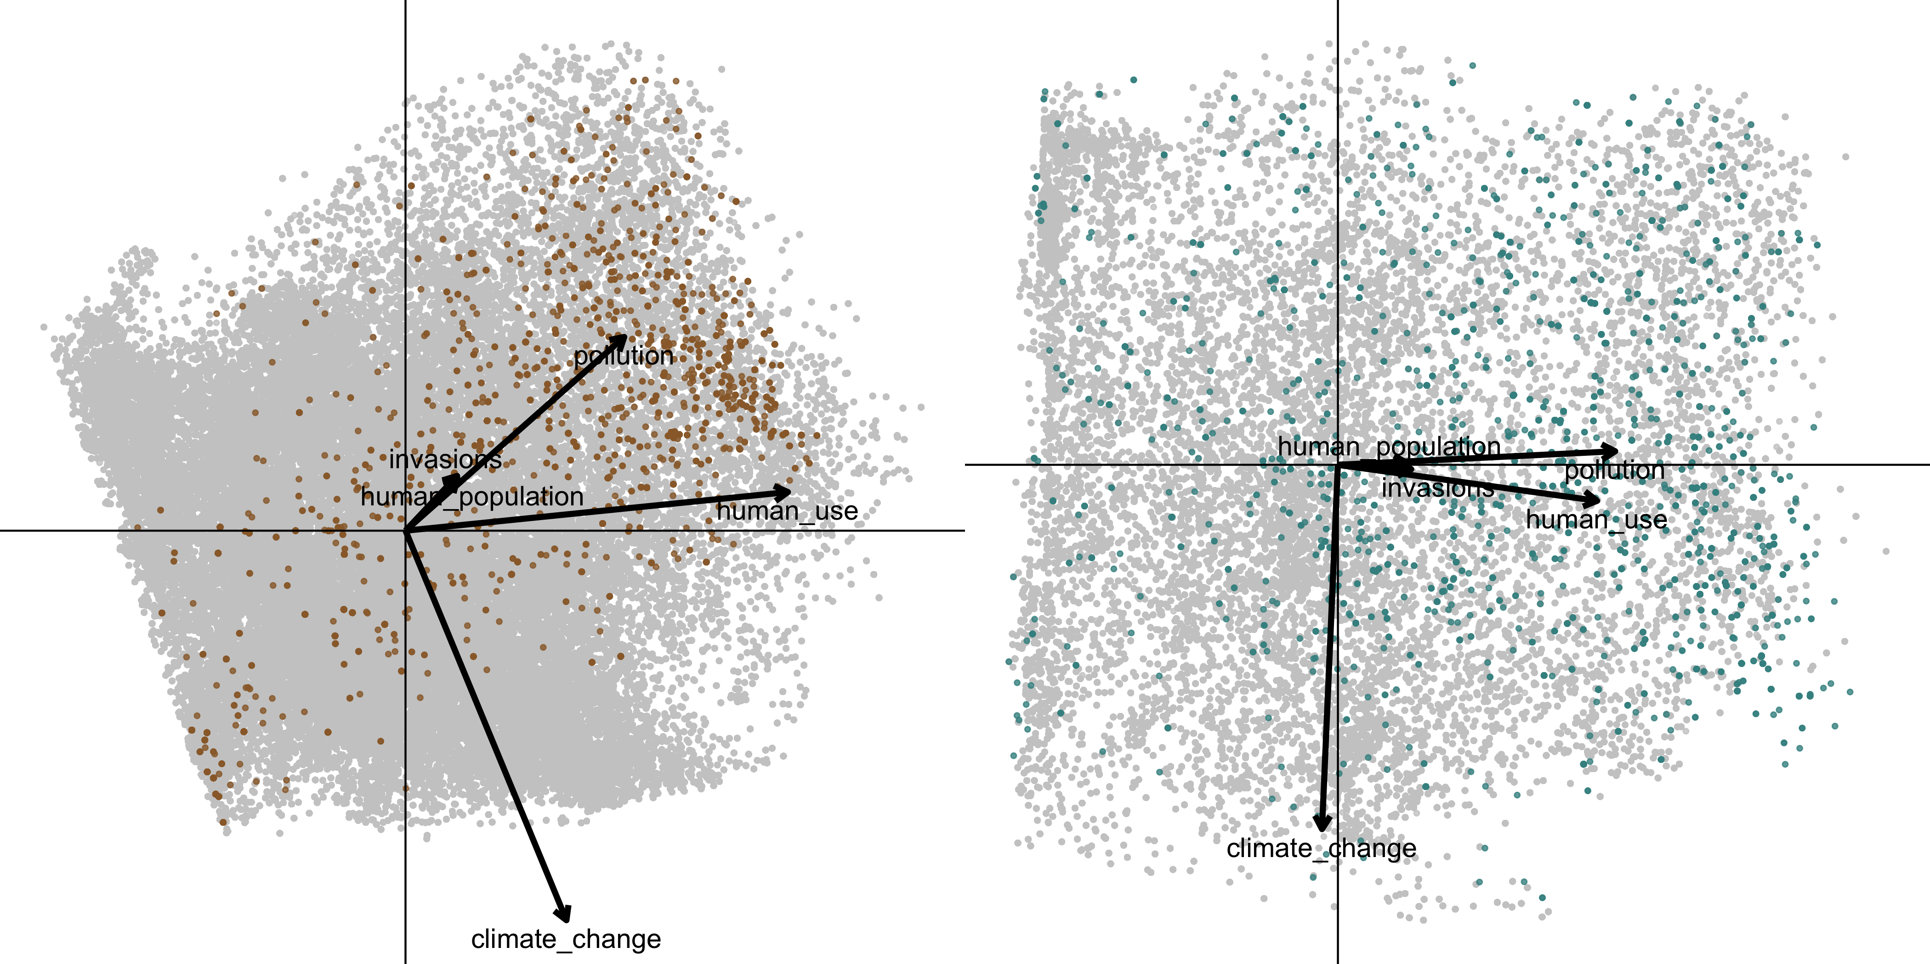
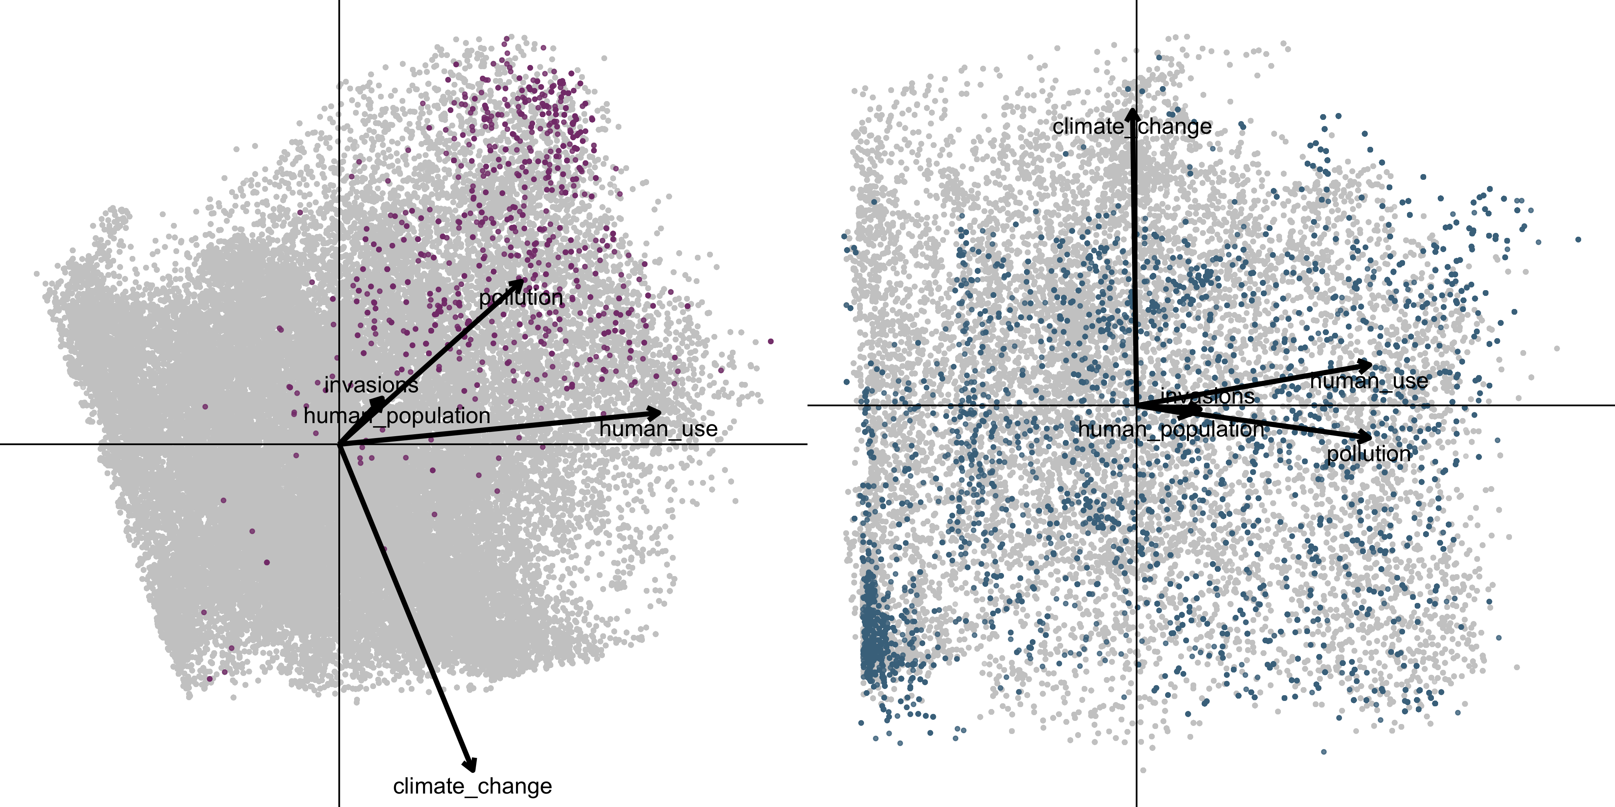
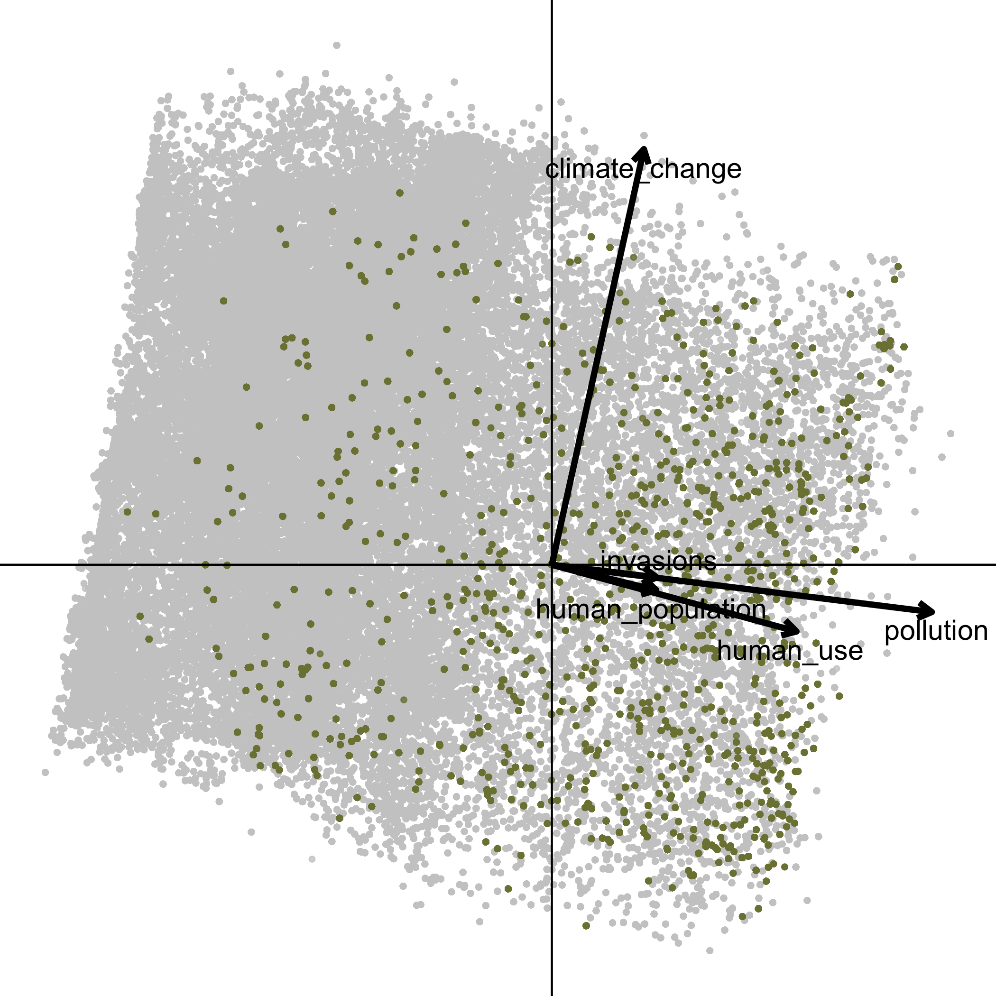
LPD BioTIME PREDICTS

